Slide 1
Stacks, Queues, Deques ADT Reading: Chapter 6 Data Structures and Algorithms in JAVA

Slide 2
Abstract Data Types (ADTs)
ADT is an abstraction of a data structure
ADT is A specification of a collection of data and the operations that can be performed on it.
Describes what a collection does, not how it does it
An ADT specifies:
Data stored
Operations on the data
Error conditions associated with operations
We don't know exactly how a stack or queue is implemented, and we don't need to.
just need to understand the idea of the collection and what operations it can perform.

Slide 3
ADT Example
ADT modeling a simple stock trading system
The data stored are buy/sell orders
The operations supported are
order buy(stock, shares, price)
order sell(stock, shares, price)
void cancel(order)
Error conditions:
Buy/sell a nonexistent stock
Cancel a nonexistent order

Slide 4
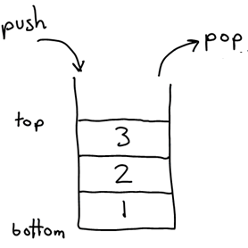

The Stack ADT
The Stack ADT stores arbitrary objects
Insertions and deletions follow the last-in first-out scheme
Think of a spring-loaded plate dispenser
Main stack operations:
push(object): inserts an element
pop(): removes the last inserted element
object top(): returns the last inserted element without removing it
Auxiliary stack operations:
integer size(): returns the number of elements stored
boolean empty(): indicates whether no elements are stored

Slide 5
Applications of Stacks
Direct applications
Page-visited history in a Web browser
Undo sequence in a text editor
Chain of method calls in the Java Virtual Machine
Indirect applications
Auxiliary data structure for algorithms
Component of other data structures
Method Stack in the JVM
The Java Virtual Machine (JVM) keeps track of the chain of active functions with a stack
When a function is called, the JVM pushes on the stack a frame containing
Local variables and return value
Program counter, keeping track of the statement being executed
When the function ends, its frame is popped from the stack and control is passed to the function on top of the stack
Allows for recursion
main() { int i = 5; foo(i); }
foo(int j) { int k; k = j+1; bar(k); }
bar(int m) { … }
bar
PC = 1 m = 6
foo
PC = 3 j = 5
k = 6
main
PC = 2 i = 5

Slide 6
Class java.util.Stack
Stack<E>() | constructs a new stack with elements of type E
push(value) | places given value on top of stack
pop() | removes top value from stack and returns it; throws EmptyStackException if stack is empty
peek() | returns top value from stack without removing it; throws EmptyStackException if stack is empty
size() | returns number of elements in stack
isEmpty() | returns true if stack has no elements
Stack<Integer> s = new Stack<Integer>();
s.push(42);
s.push(-3);
s.push(17); // bottom [42, -3, 17] top
System.out.println(s.pop()); // 17

Slide 7
Class java.util.Stack
Suppose we're asked to write a method max that accepts a Stack of integers and returns the largest integer in the stack
// Precondition: s.size() > 0
public static int max(Stack<Integer> s) {
int maxValue = s.pop();
while (!s.isEmpty()) {
int next = s.pop();
maxValue = Math.max(maxValue, next);
}
return maxValue;
}
The algorithm is correct, but what is wrong with the code?
The code destroys the stack in figuring out its answer.

Slide 8
Class java.util.Stack
you must save and restore the stack's contents:
public static int max(Stack<Integer> s) {
Stack<Integer> backup = new Stack<Integer>();
int maxValue = s.pop();
backup.push(maxValue);
while (!s.isEmpty()) {
int next = s.pop();
backup.push(next);
maxValue = Math.max(maxValue, next);
}
while (!backup.isEmpty()) {
s.push(backup.pop());
}
return maxValue;
}

Slide 9
Our Stack ADT in JAVA
Java interface corresponding to our Stack ADT
Assumes null is returned from top() and pop() when stack is empty
Different from the built-in Java class java.util.Stack
Methods of our stack ADT and corresponding methods of the class java.util.Stack, with differences highlighted.
public interface Stack<E> {
int size(); // Returns the number of elements in the stack.
boolean isEmpty(); //Tests whether the stack is empty.
void push(E e); //Inserts an element at the top of the stack.
E top(); //Returns, but does not remove, the element at the top of the stack
E pop(); //Removes and returns the top element from the stack.
}

Slide 10
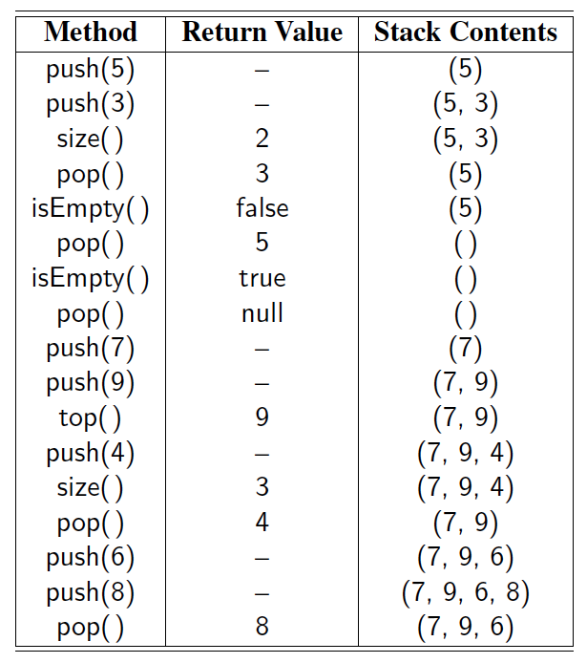
Example

Slide 11
Exceptions vs. Returning Null
Attempting the execution of an operation of an ADT may sometimes cause an error condition
Java supports a general abstraction for errors, called exception
An exception is said to be “thrown” by an operation that cannot be properly executed
In our Stack ADT, we do not use exceptions
Instead, we allow operations pop and top to be performed even if the stack is empty
For an empty stack, pop and top simply return null

Slide 12
Simple implementation of stack of int reusing our IntLinkedList
public class IntStack {
private IntLinkedList stack;
public IntStack(){
stack = new IntLinkedList()
}
public void push(int value){
stack.addFirst(value);
}
public int pop(){
return stack.removeFirst();
}
public int top(){
return stack.first();
}
public boolean isEmpty(){
return stack.isEmpty();
}
}

Slide 13
Client Program for IntStack
Class StackApp{
public static void main (String[] args){
IntStack myStack = new IntStack();
myStack.push(20);
myStack.push(40);
myStack.push(60);
while (!myStack.isEmpty()) {
int value = myStack.pop();
System.out.print(value);
System.out.print(“ “);
}
System.out.println(“”);
}
}
data | next
0
data | next
0
data | next
0
front
.
40
20
60

Slide 14
Generic Stack using LinkedList<E>
public class LinkedStack<E> implements Stack<E> {
private LinkedList<E> list = new LinkedList<>( ); // an empty list
public LinkedStack( ) { } // new stack relies on the initially empty list
public int size( ) {
return list.size( );
}
public boolean isEmpty( ) {
return list.isEmpty( );
}
public void push(E element) {
list.addFirst(element);
}
public E top( ) {
return list.first( );
}
public E pop( ) {
return list.removeFirst( );
}
}

Slide 15
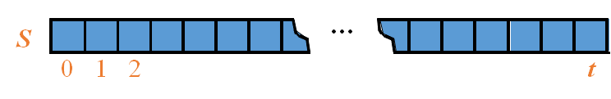
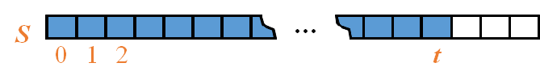
Array-based Stack
Algorithm size()
return t + 1
Algorithm pop()
if empty() then
return null
else
t ← t − 1
return S[t + 1]
A simple way of implementing the Stack ADT uses an array
We add elements from left to right
A variable keeps track of the index of the top element
The array storing the stack elements may become full
A push operation will then throw a FullStackException exception
Not intrinsic to the Stack ADT
Algorithm push(o)
if t = S.size() − 1 then
throw IllegalStateException
else
t ← t + 1
S[t] ← o

Slide 16
Performance and Limitations
Performance
Let n be the number of elements in the stack
The space used is O(n)
Each operation runs in time O(1)
Limitations
The maximum size of the stack must be defined a priori and cannot be changed
Trying to push a new element into a full stack causes an implementation-specific exception

Slide 17
Implementing stack of Integers using array
Simple implementation: The stack consists of an array A of maxSize elements, an integer variable top, which is the index of the top element in array A.
A
0
1
2
top-1
top
maxSize-1
class StackInt{
private int maxSize;
private int[] A;
private int t;
public StackInt (int maxSize) {
this.maxSize= maxSize;
A = new int[maxSize];
t = -1;
}
public void push(int o) {
A[++t]=o;
}
public int pop() {
return A[t--];
}
public int top() {
return A[top];
}
public boolean isEmpty(){
return (t==-1);
}
public int size(){
return (t+1);
}
}

Slide 18
Implementing stack of Integers using array
Class StackApp{
public static void main (String[] args){
StackInt myStack = new StackInt(10);
myStack.push(20);
myStack.push(40);
myStack.push(60);
while (!myStack.isEmpty()) {
int value = myStack.pop();
System.out.print(value);
System.out.print(“ “);
}
System.out.println(“”);
}
}
A
20
40
60
0
1
2
9
top

Slide 19
Generic Array-based Stack in JAVA
public class ArrayStack<E> implements Stack<E> {
public static final int CAPACITY=1000; // default array capacity
private E[] S; // holds the stack elements
private int t = -1; // index to top element
public ArrayStack(int capacity) { // constructor S = (E[]) new Object[capacity]); }
public ArrayStack(){ this(CAPACITY); }// stack with default capacity
public int size() { //Returns the number of elements in the stack.
return (t + 1);
}
public boolean isEmpty() { //Tests whether the stack is empty
return (t == -1);
}
public E top() {
if (isEmpty()) return null;
return S[t];
}

Slide 20
Array-based Stack in JAVA
public E pop() { //Removes and returns the top element from the stack
if isEmpty() return null; E temp = S[t]; S[t] = null; // facilitate garbage collection (see below notes) t--; return temp; }
// holds the stack elements public void push(E e) throws IllegalStateException {
if (size() == S.length) throw new IllegalStateException("Stack is full");
S[++t] = e; // increment t before storing new item
}
}
Notes:
Garbage Collection in Java
We wish to draw attention to one interesting aspect involving the implementation of
the pop method in Code Fragment 6.2. We set a local variable, answer, to reference
the element that is being popped, and then we intentionally reset data[t] to null at
line 22, before decrementing t. The assignment to null was not technically required,
as our stack would still operate correctly without it.
Our reason for returning the cell to a null reference is to assist Java’s garbage
collection mechanism, which searches memory for objects that are no longer actively
referenced and reclaims their space for future use. (For more details, see
Section 15.1.3.) If we continued to store a reference to the popped element in our
array, the stack class would ignore it (eventually overwriting the reference if more
elements get added to the stack). But, if there were no other active references to the
element in the user’s application, that spurious reference in the stack’s array would
stop Java’s garbage collector from reclaiming the element.

Slide 21
Example
Stack<Integer> S = new ArrayStack<>( ); // contents: ()
S.push(5); // contents: (5)
S.push(3); // contents: (5, 3)
System.out.println(S.size( )); // contents: (5, 3) outputs 2
System.out.println(S.pop( )); // contents: (5) outputs 3
System.out.println(S.isEmpty( )); // contents: (5) outputs false
System.out.println(S.pop( )); // contents: () outputs 5
System.out.println(S.isEmpty( )); // contents: () outputs true
System.out.println(S.pop( )); // contents: () outputs null
S.push(7); // contents: (7)
S.push(9); // contents: (7, 9)
System.out.println(S.top( )); // contents: (7, 9) outputs 9
S.push(4); // contents: (7, 9, 4)
System.out.println(S.size( )); // contents: (7, 9, 4) outputs 3
System.out.println(S.pop( )); // contents: (7, 9) outputs 4
S.push(6); // contents: (7, 9, 6)
S.push(8); // contents: (7, 9, 6, 8)
System.out.println(S.pop( )); // contents: (7, 9, 6) outputs 8

Slide 22
Parentheses Matching
Each “(”, “{”, or “[” must be paired with a matching “)”, “}”, or “[”
correct: ( )(( )){([( )])}
correct: ((( )(( )){([( )])}
incorrect: )(( )){([( )])}
incorrect: ({[ ])}
Algorithm ParenMatch(X,n):
Input: An array X of n tokens, each of which is either a grouping symbol, a variable, an arithmetic operator, or a number
Output: true if and only if all the grouping symbols in X match
Let S be an empty stack
for i=0 to n-1 do
if X[i] is an opening grouping symbol then
S.push(X[i])
else if X[i] is a closing grouping symbol then
if S.empty() then
return false {nothing to match with}
if S.pop() does not match the type of X[i] then
return false {wrong type}
if S.empty() then
return true {every symbol matched}
else return false {some symbols were never matched}

Slide 23
Evaluating Arithmetic Expressions
14 – 3 * 2 + 7 = (14 – (3 * 2) ) + 7
Operator precedence
* has precedence over +/–
Associativity
operators of the same precedence group
evaluated from left to right
Example: (x – y) + z rather than x – (y + z)
Idea: push each operator on the stack, but first pop and perform higher and equal precedence operations.

Slide 24
Algorithm for Evaluating Expressions
Algorithm doOp()
x ← valStk.pop();
y ← valStk.pop();
op ← opStk.pop();
valStk.push( y op x )
Algorithm repeatOps( refOp ):
while ( valStk.size() > 1 ∧ prec(refOp) ≤ prec(opStk.top())
doOp()
Algorithm EvalExp()
Input: a stream of tokens representing an arithmetic expression (with numbers)
Output: the value of the expression
while there’s another token z
if isNumber(z) then
valStk.push(z)
else
repeatOps(z);
opStk.push(z)
repeatOps($);
return valStk.top()
Two stacks:
opStk holds operators
valStk holds values
Use $ as special “end of input” token with lowest precedence

Slide 25
Algorithm on an Example Expression
Operator ≤ has lower precedence than +/–
14 ≤ 4 – 3 * 2 + 7
4
–
14
≤
3
*
$
$
4
–
7
$
14
≤
F
+
-2
+
5
+
14
≤
14
≤
2
2
3
*
3
*
6
4
–
4
–
4
–
-2
+
14
≤
14
≤
14
≤
14
≤

Slide 26
The Queue ADT
The Queue ADT stores arbitrary objects
Insertions and deletions follow the first-in first-out scheme
Insertions are at the rear of the queue and removals are at the front of the queue
Rear
front
Main queue operations:
enqueue(object): inserts an element at the end of the queue
dequeue(): removes the element at the front of the queue
Auxiliary queue operations:
object first(): returns the element at the front without removing it
integer size(): returns the number of elements stored
boolean isEmpty(): indicates whether no elements are stored
Boundary cases
Attempting the execution of dequeue or first on an empty queue returns null

Slide 27
Example
Operation Output Q
enqueue(5) – (5)
enqueue(3) – (5, 3)
dequeue() 5 (3)
enqueue(7) – (3, 7)
dequeue() 3 (7)
first() 7 (7)
dequeue() 7 ()
dequeue() null ()
isEmpty() true ()
enqueue(9) – (9)
enqueue(7) – (9, 7)
size() 2 (9, 7)
enqueue(3) – (9, 7, 3)
enqueue(5) – (9, 7, 3, 5)
dequeue() 9 (7, 3, 5)

Slide 28
java.util.Queue Interface in Java
add(value) | places given value at back of queue
remove() | removes value from front of queue and returns it; throws a NoSuchElementException if queue is empty
peek() | returns front value from queue without removing it; returns null if queue is empty
size() | returns number of elements in queue
isEmpty() | returns true if queue has no elements
Queue<Integer> q = new LinkedList<Integer>();
q.add(42);
q.add(-3);
q.add(17); // front [42, -3, 17] back
System.out.println(q.remove()); // 42
IMPORTANT: When constructing a queue you must use a new LinkedList object instead of a new Queue object.

Slide 29
Queue Interface in Java
Java interface corresponding to our Queue ADT
Assumes that first() and dequeue() return null if queue is empty
public interface Queue<E> {
int size();
boolean isEmpty();
E first();
void enqueue(E e);
E dequeue(); }
java.util.Queue supports two styles for most operations :
When a queue is empty, the remove( ) and element( ) methods throw a NoSuchElementException, while the corresponding methods poll( ) and peek( ) return null.
When full, the add method will throw an IllegalStateException, while the offer method ignores the new element and returns false to signal that theelement was not accepted

Slide 30
Reusing our Generic LinkedList
public class LinkedQueue<E> implements Queue<E> {
/** The primary storage for elements of the queue */
private LinkedList<E> list = new LinkedList<>(); // an empty list
/** Constructs an initially empty queue. */
public LinkedQueue() { } // new queue relies on the initially empty list
/** Returns the number of elements in the queue. */
public int size() { return list.size(); }
/** Tests whether the queue is empty. */
public boolean isEmpty() { return list.isEmpty(); }
/** Inserts an element at the rear of the queue. */
public void enqueue(E element) { list.addLast(element); }
/** Returns, but does not remove, the first element of the queue. */
public E first() { return list.first(); }
/** Removes and returns the first element of the queue. */
public E dequeue() { return list.removeFirst(); }
/** Produces a string representation of the queue.(from front to back).*/
public String toString() {
return list.toString();
}
}

Slide 31
Reusing our Generic LinkedList
public class QueueIntApp {
public static void main(String[] args){
Queue<Integer> q = new LinkedQueue<E <>( );// contents: ()
q.enqueue(20);
q.enqueue(30);
q.enqueue(40);
q.dequeue();
q.dequeue();
}
}

Slide 32
Array-based Queue: using the Modulo Operator to Implement a Circular Array
Use an array of size N in a circular fashion
Two variables keep track of the front and rear
f index of the front element
sz number of items in the queue
When the queue has fewer than N elements, array location
r = (f + sz) mod N
is the first empty slot past the rear of the queue
normal configuration
Q
0
1
2
f
r
wrapped-around configuration
Q
0
1
2
r
f

Slide 33
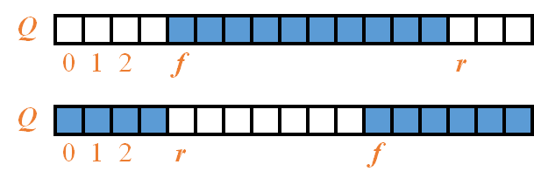
Queue Operations
Algorithm size()
return sz
Algorithm empty()
return (sz == 0)
Algorithm enqueue(o)
if size() = N − 1 then
throw IllegalStateException
else
r ← (f + sz) mod N
Q[r] ← o
sz ← sz + 1
Algorithm dequeue()
if isEmpty() then
return null
else
o ← Q[r]
f ← (f + 1) mod N
sz ← sz − 1
Use sz to determine size and emptiness
Operation enqueue throws an exception if the array is full
Operation dequeue returns null if the queue is empty

Slide 34
Array-Based Implementation
public class ArrayQueue<E> implements Queue<E> {
/** Default array capacity. */
public static final int CAPACITY = 1000; // default array capacity
private E[] data; // generic array used for storage
private int f = 0; // index of the front element
private int sz = 0; // current number of elements
// constructors
public ArrayQueue() {this(CAPACITY);} // constructs queue with default capacity
public ArrayQueue(int capacity) { // constructs queue with given capacity
data = (E[]) new Object[capacity]; // safe cast; compiler may give warning
}
// methods
/** Returns the number of elements in the queue. */
public int size() { return sz; }
/** Tests whether the queue is empty. */
public boolean isEmpty() { return (sz == 0); }
/**Inserts an element at the rear of the queue */
public void enqueue(E e) throws IllegalStateException {
if (sz == data.length) throw new IllegalStateException("Queue is full");
int avail = (f + sz) % data.length; // use modular arithmetic
data[avail] = e;
sz++;
}

Slide 35
/** Returns, but does not remove, the first element of the queue.*/
public E first() {
if (isEmpty()) return null;
return data[f];
}
/** Removes and returns the first element of the queue. */
public E dequeue() {
if (isEmpty()) return null;
E answer = data[f];
data[f] = null; // dereference to help garbage collection
f = (f + 1) % data.length;
sz--;
return answer;
}
/** Returns a string representation of the queue as a list of elements. */
public String toString() {
StringBuilder sb = new StringBuilder("(");
int k = f;
for (int j=0; j < sz; j++) {
if (j > 0)
sb.append(", ");
sb.append(data[k]);
k = (k + 1) % data.length;
}
sb.append(")");
return sb.toString();
}
}
Array-Based Implementation

Slide 36
Applications of Queues
Waiting lists, bureaucracy
Access to shared resources (e.g., printer)
Multiprogramming
Round Robin Schedulers
We can implement a round robin scheduler using a queue Q by repeatedly performing the following steps:
e = Q.dequeue()
Service element e
Q.enqueue(e)
Queue
Dequeue
Enqueue
Shared Service

Slide 37
Double-Ended Queues
Queue-like data structure that supports insertion and deletion at both the front and the rear of the queue
usually pronounced “deck”
All operations are in the constant order of complexity O(1)
Our ADT consists of the following methods:

Slide 38
Double-Ended Queues: operations and comparison to Java native Deque
It can be easily implemented using array or doubly linked list with o(1) for all operations

